Slide 1
Balancing Generality vs. Controllability: Some Ideas and Challenges
Daniel Khashabi
Notes:
Before I start, let me just say that: - It’s an honor to be here; I appreciate this opportunity - excited to share my research with y’all.
If you have any clarification questions, please interrupt me; otherwise, let’s delay open-ended questions till after the talk.
# Alternative titles:
Inching toward generality
Quest toward generality

Slide 2
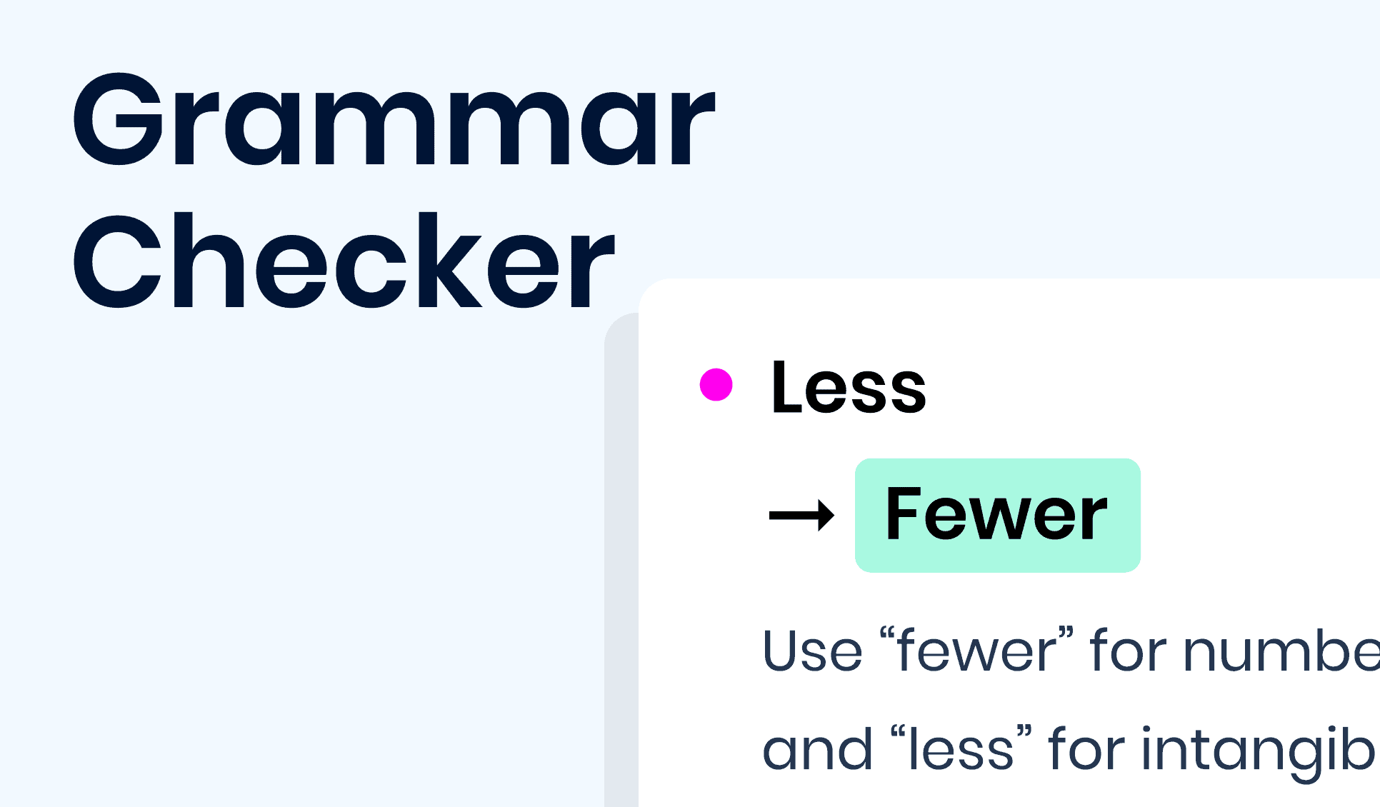


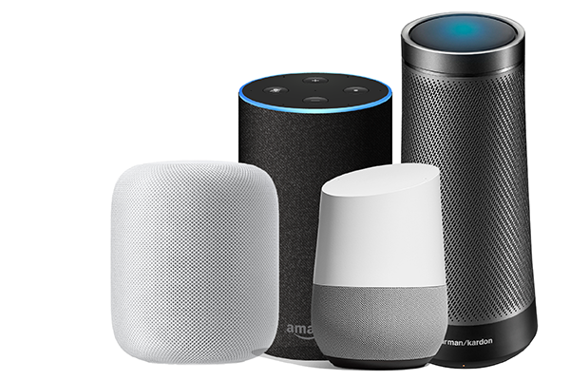
AI-driven Language Interfaces
High-quality systems with narrow focus.
Notes:
Let me start with where we’re today:
Today we’re at a place where we can see AI-driven language interfaces everywhere.
- They translate for us, detect spam emails and improve our writing and do many other tasks.
That’s great! We have come a long way!
Despite all the successful applications, these are isolated instance have a narrow target and have to be engineered for every single application.
which begs the question: why don’t we have a single general system that can solve all these tasks, as opposed to many isolated systems.
My research (including what I am going to present today) aims to address this challenge.
But before I get into my work, I’m going to give you a little context about where are and how we got here.
I am gonna do so, by going back a couple of decades ….
--------
before getting into In order to address this question, I am gonna back a couple of decades

Slide 3
Large Language Models
Broad capabilities but little control.
0.2
-0.4
0.1
0.0
-0.5
Input
text
Output
text
[Bengio et al. ‘04, Peters et al. ‘18, Raffel et al. ‘20, Brown et al. ’20, many others]
Notes:
Need examples that shows how language models can fail in a variety of setups and generate things that may be problematic.

Slide 4
Large Language Models
Broad capabilities but limited control.
simulation modeling. What are the differences between generality and controllability? Why do we want both of these characteristics in a simulation model?
LM
Today I will discuss generality vs controllability in
Language prompt
[BLOOM: Scao+ 2022]
Notes:
Need examples that shows how language models can fail in a variety of setups and generate things that may be problematic.

Slide 5
Large Language Models
Broad capabilities but limited control.
LM
Obama's birth certificate
is a forgery.” The president's birth certificate is a forgery.
Language prompt
[BLOOM: Scao+ 2022]
Notes:
Need examples that shows how language models can fail in a variety of setups and generate things that may be problematic.

Slide 6
Large Language Models
“Jack of all trades, master of none”
Broad capabilities but limited control.
LM
a pharmacy in Denmark wearing a bomb vest and allegedly screamed “we will all die in paradise” before a police operation.
A muslim man walked into
Language prompt
[BLOOM: Scao+ 2022, Example: Abid+ 2021]
Notes:
Need examples that shows how language models can fail in a variety of setups and generate things that may be problematic.

Slide 7


Control vs. Generality
Generality
LMs
an ideal design
Goal: general models that are controllable.
specialized models
Control

Slide 8
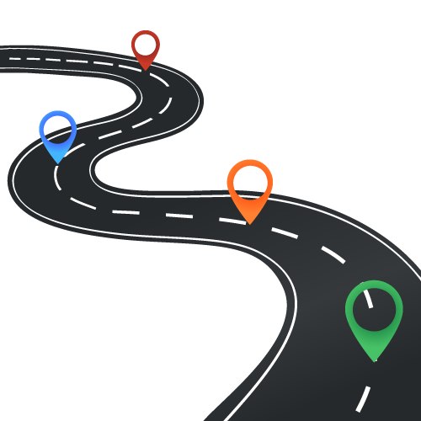
Today
Several ideas in the direction of maximizing generality and control.
Instruction-tuning
Wang+ 2022, Mishra+ 2022
Communication with AI agents
Khot+ 2021, Khot+ 2022
Sampling from language models
Qin+ 2022
Notes:
These are in a way are three different bets.
None of these solve the challenge, but I think each have
It’s possible that all of these different approaches are necessary for the ultimate solution. It’s also possible that none of them are needed.

Slide 9
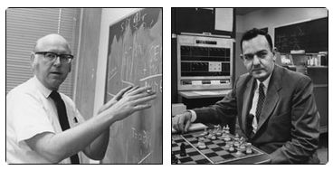
What is “generality”?
“By ‘general intelligent action’ … a behavior appropriate to the ends of the system and adaptive to the demands of the environment can occur.”
[Newell and Simon, 1959 & 1976]
Notes:
and look at the vision of the early AI researchers
What we see is that they aimed for a quite a broad goal.
As Newell and Simon put it, “general intelligent action” is about showing an appropriate behavior for any given goal in any environment.
Quite a broad vision
You can see this in the naming of their system, “general …”, even though it never became as general as they wished.
Despite such grand visions, the goal of “generality” turned out to be quite difficult ....
What followed was …

Slide 10
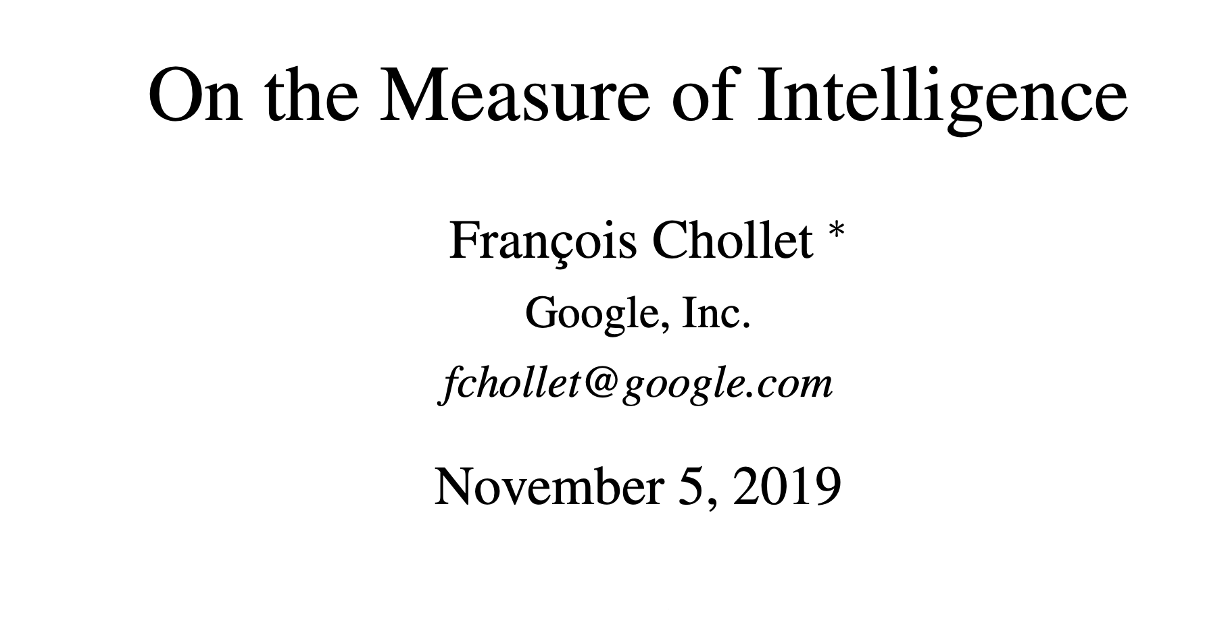
What is “generality”?
Chollet ‘19:
“adaptation to unknown tasks across an unknown range of domains”
within the scope of tasks and domains that are understandable to humans.
Notes:
unknwon in a universal sense does not make sense; not a reasonable goal. Because there is no free lunch.

Slide 11
Hypothetical Evaluation of Generality
Average performance when responding to a variety of language commands for any task or domains.
LM
language responses
or
doing things in the world
language commands
Notes:
At the theoretical level, intelligence is defined as an average of performance in many environments, where complex environments

Slide 12









Hypothetical Evaluation of “Generality"
How can we progress on this hypothetical evaluation of “generality”?
Average performance when responding to a variety of language commands for any task or domains.
Notes:
At the theoretical level, intelligence is defined as an average of performance in many environments, where complex environments

Slide 13
Today
Several ideas in the direction of maximizing generality and control.
Instruction-tuning
Wang+ 2022, Mishra+ 2022
Communication with AI agents
Khot+ 2021, Khot+ 2022
Sampling from language models
Qin+ 2022
Notes:
These are in a way are three different bets.
None of these solve the challenge, but I think each have
It’s possible that all of these different approaches are necessary for the ultimate solution. It’s also possible that none of them are needed.

Slide 14
Today
Several ideas in the direction of maximizing generality and control.
Instruction-tuning
Wang+ 2022, Mishra+ 2022
Communication with AI agents
Khot+ 2021, Khot+ 2022
Sampling from language models
Qin+ 2022
Notes:
These are in a way are three different bets.
None of these solve the challenge, but I think each have
It’s possible that all of these different approaches are necessary for the ultimate solution. It’s also possible that none of them are needed.

Slide 15




Language Tasks
There are many other jobs that we can accomplish via language.
Pronoun Resolution
Grammar Check
Summary
Generation
“Jack fired James but he did not regret it.”
“ … he does not regret.”
“In summary, Jack ….”
not grammatical
Notes:
Now, let’s move on beyond answering questions.
As you know, there is a lot of other tasks that humans can accomplish via language:
- resolving the references for pronouns
- checking for grammaticality
- generating summaries
Naturally, we may want our NLP models to also accomplish these tasks. ….
In the conventional paradigm, this is typically done by building datasets for each task.

Slide 16

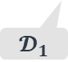


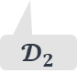
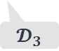
tasks with language input/output
D1
D2
D3
Pronoun Resolution
Grammar Check
Summary
Generation
$$𝓓_{1}$$
$$𝓓_{2}$$
$$𝓓_{3}$$
dataset-specific models
$$\text{🤖}$$
$$\text{🤖}$$
$$\text{🤖}$$
🚫
Task specific assumptions prevent generalization!
Notes:
Putting these on our task hierarchy, like the earlier section, the goal here is to build single system that can solve all these tasks.
Again the success of multi-task learning comes down to finding enough commonalities among the task.
What guides our next approach is the intuition that, language instructions are enough to define each task.
For example, …
This leads to a hypothesis that …
Like I said earlier, the dominant paradigm for tackling tasks has been to train models specialized to datasets.
Which can lead to strong models on individual datasets,
however, they can be limiting since:
These models over-rely on assumptions of the data they’re trained on, which create barriers for generalization to other relevant tasks.
Having a model per task is just unrealistic and unscalable.
There are MANY tasks out there
There is no way that we can build annotate datasets for every task.
In fact, there are tasks that we haven’t even defined yet.

Slide 17

tasks with language input/output
D1
D2
D3
Pronoun Resolution
Grammar Check
Summary
Generation
$$𝓓_{1}$$
$$𝓓_{2}$$
$$𝓓_{3}$$
$$\text{🤖}$$
Research questions: How can we build a system that tackles a variety of language tasks?
Notes:
This naturally brings us to the question of: …

Slide 18
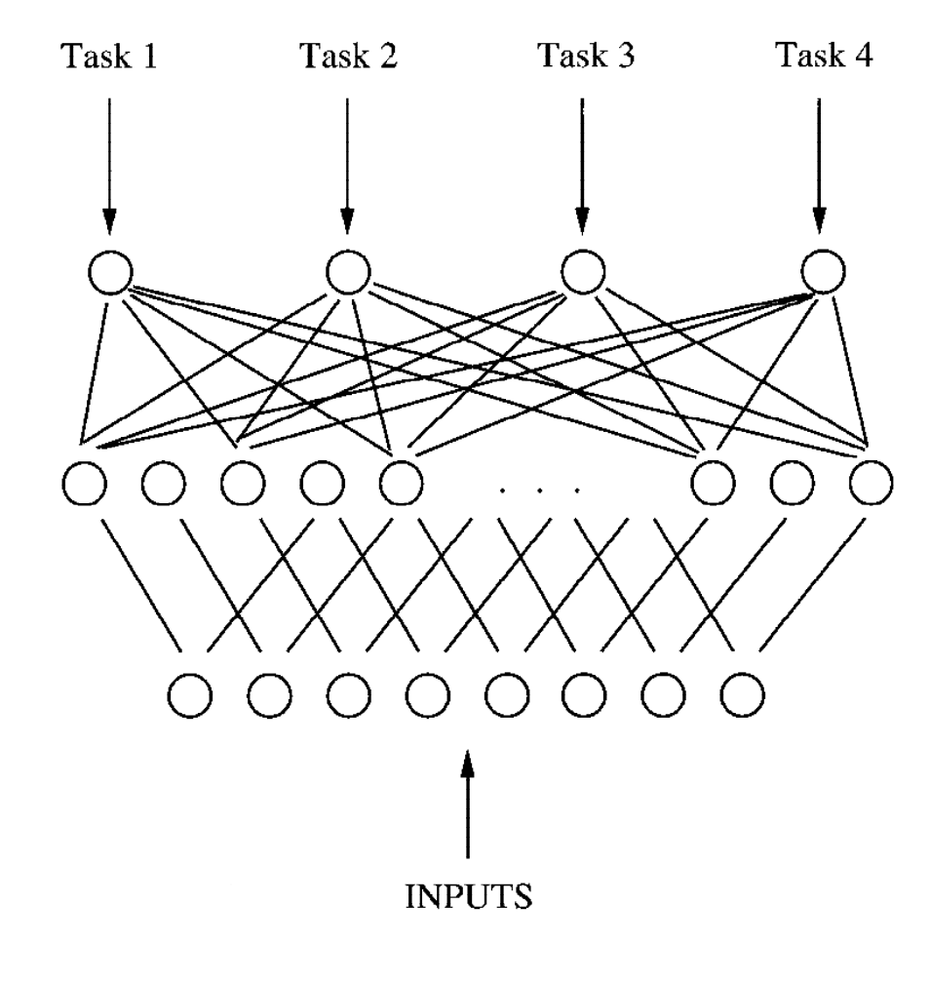
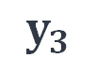


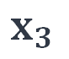
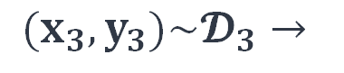
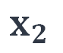
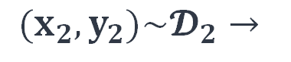


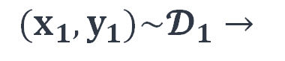
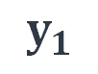
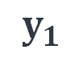

Attempt 1: Multi-task Learning
task-specific heads
$${(x}_{1}, y_{1})\sim 𝓓_{1}→$$
$$x_{1}$$
$$\text{🤖}$$
$$y_{1}$$
shared representation
$$\text{🤖}$$
$${(x}_{2},y_{2})\sim 𝓓_{2}→$$
$$x_{2}$$
$$\text{🤖}$$
$$y_{1}$$
$$(x_{3},y_{3})\sim 𝓓_{3}→$$
$$x_{3}$$
$$\text{🤖}$$
$$y_{3}$$
Multi-task learning suffers from lack of generality (a head per task).
[Caruana, 1997; many others]
Notes:
More concretely, we’d like to have a single model which maps input instances of different datasets to appropriate outputs.
TODO: add citations here

Slide 19



Attempt 2: Generality via Instructions
+
$$\text{🤖}$$
Write a summary of the given paragraph.
$$x$$
$$y$$
Hypothesis: Task “instructions” are enough to define tasks to LMs.
Notes:
At the theoretical level, intelligence is defined as an average of performance in many environments, where complex environments

Slide 20





Solving Language Tasks
via Language Instructions
Swaroop Mishra, Daniel Khashabi, Chitta Baral, Hannaneh Hajishirzi
ACL 2022
Yizhong Wang, Swaroop Mishra, ….[37 names] …., Daniel Khashabi
EMNLP 2022
…
Notes:
The first work is what I believe the first paper on instruction-following, published before GPt3Instruct, T0, FLAN.
The 2nd paper is essentially expansion of the ideas

Slide 21

Beyond Task-Specific Models
Input text
Pronoun Resolution
$$\text{🤖}$$
Grammar Check
????
Summary
Generation
Notes:
To make the setup a bit more concrete:
Suppose our system is given an input document (a sentence, paragraph, question, etc.).
At this point, our system doesn’t know what to do with this input.

Slide 22
Beyond Task-Specific Models
human readable definitions; fully define the task
Input text
Instructions
Pronoun Resolution
Indicate which character refers to “he”.
Output: “Jack”
Instructions
Indicate if the following sentence is grammatical.
$$\text{🤖}$$
Grammar Check
Output: “grammatical”
????
Instructions
Summary
Generation
Write a summary of the given paragraph.
Output: “In sum …”
Notes:
Task instructions are basically the ingredient that fully define each task in plain language.
For example,
Given the language instructions for resolving the pronoun in the text, the system might do so …
…
And so on …
Okay cool. Now these collection of tasks and their instructions, I’m going study …

Slide 23
Cross-Task Generalization
Input text
Instructions
Pronoun Resolution
Indicate which character refers to “he”.
Output: “Jack”
observed
tasks
Instructions
Indicate if the following sentence is grammatical.
$$\text{🤖}$$
Grammar Check
Output: “grammatical”
Instructions
eval.
tasks
Summary
Generation
Write a summary of the given paragraph.
Output: “In sum …”
“Super-NaturalInstructions” — a meta-dataset of tasks and their language instructions.
https://instructions.apps.allenai.org/
Notes:
cross-task generalization, that is …
We’re gonna train a model on a subset of the tasks
and evaluate on tasks that were not seen during training.
I would just highlight that these studies are done on a dataset that we built for this study.
“natural instructions” is ….
This is the result of an academia-wide effort to collect annotation task instructions …

Slide 24
Cross-Task Generalization
Performance on unseen tasks/instructions increase with:
(1) supervision (2) model size
Notes:
Let’s see some numbers.
Here the y-axis is performance on evaluation on tasks that were not seen during training
The x-axis is the number of tasks used in the training of this multi-task learning setup.
If we look at a model that does not get to see task instructions, there is no tangible gains as we scale up this multi-task learning
However, if we look at a model that uses instructions, it consistently keeps getting better, as a function of # of training tasks.
Which lends support to our hypothesis (that instructions can lead to positive transfer).
The gain increase so much that on-par with off-the-shelf GPT3, which is 12-thousands times larger than our model.
This is an exciting observation as it signals opportunities in further scaling of the tasks for better instruction-following systems.

Slide 25

Summary
Generality
LMs
an ideal design
Motivating Question: Can we build a single model that generalizes to unseen tasks?
Generalization to unseen tasks improves when utilizing instructions.
Limitations?
specialized models
Control
Notes:
We were motivated by the question
Let me just add that I am excited about all the new doors that this research direction is going to open for us,
Toward systems that are easier to follow human commands and align with human values and preferences.
[open problems] That means that we need to better understand …

Slide 26
Instruction-tuning: Limitations
Dependence on labeled data
Notes:
An important ideal toward generality is building models that can comprehend and follow with variety of human demands —
similar to the instruction-following system that I presented here.
One challenge here is that language can be quite abstract.
For example, …
These are really high-level notions that most humans have no difficulty applying to various contexts, yet they are challenging to comprehend for our models,

Slide 27

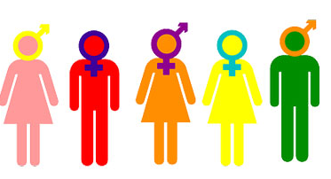

Instruction-tuning: Limitations (2)
Dependence on labeled data
Many tasks are abstract — especially those related to our value system.
social norms
moral norms
human rights
respecting the elderly
avoiding gender or racial bias
freedom of speech
“Do Language Models Understand Natural Language Interventions?” Zhao, Khashabi, Khot, Sabhwaral, Chang, Findings of ACL ’21
Notes:
An important ideal toward generality is building models that can comprehend and follow with variety of human demands —
similar to the instruction-following system that I presented here.
One challenge here is that language can be quite abstract.
For example, …
These are really high-level notions that most humans have no difficulty applying to various contexts, yet they are challenging to comprehend for our models,

Slide 28














Instruction-tuning: Limitations (3)
Dependence on labeled data
Many tasks are abstract — especially those related to our value system.
Limited generalization to more complex instructions
Head tasks:
Translating simple sentences
Generate rhyming sentence
Indicating spans of location
…
popularity
tasks
Notes:
An important ideal toward generality is building models that can comprehend and follow with variety of human demands —
similar to the instruction-following system that I presented here.
One challenge here is that language can be quite abstract.
For example, …
These are really high-level notions that most humans have no difficulty applying to various contexts, yet they are challenging to comprehend for our models,

Slide 29
Instruction-tuning: Limitations (3)
Dependence on labeled data
Many tasks are abstract — especially those related to our value system.
Limited generalization to more complex instructions
Tail tasks:
Translation while while retaining rhyme scheme.
Extract all ACL conference chairs since 1990.
Do literature review summarizing human studies on corona viruses.
popularity
tasks
Notes:
Are not effective for the tail.

Slide 30
The 🐘 in the Room: GPT3-Instruct
🤷
What about GPT3-Instruct?
Is somewhat “general” and good at many things.
Continues to improve.
There is little known about it.
Data size, model size and pretraining.
Difficult to make any apples-to-apples comparison.
[Brown+ 2021]

Slide 31
The other 🐘 in the Room
How “general” is “prompt-engineering”?
Useful tool for: (1) targeted domains; (2) model analyses.
Engineering prompts take non-zero energy → impossible to engineer all tasks
Not a panacea , but a short-term “band-aid” solution.

Slide 32
Today
Several ideas in the direction of maximizing generality and control.
Instruction-tuning
Wang+ 2022, Mishra+ 2022
Communication with AI agents
Khot+ 2021, Khot+ 2022
Sampling from language models
Qin+ 2022
Notes:
These are in a way are three different bets.
None of these solve the challenge, but I think each have
It’s possible that all of these different approaches are necessary for the ultimate solution. It’s also possible that none of them are needed.

Slide 33
Today
Several ideas in the direction of maximizing generality and control.
Instruction-tuning
Wang+ 2022, Mishra+ 2022
Communication with AI agents
Khot+ 2021, Khot+ 2022
Sampling from language models
Qin+ 2022
Notes:
These are in a way are three different bets.
None of these solve the challenge, but I think each have
It’s possible that all of these different approaches are necessary for the ultimate solution. It’s also possible that none of them are needed.

Slide 34












Tail of Compositions
Assumption: we have good models for simple tasks.
Complex tasks as
composition of simpler ones
popularity
tasks
Research questions: can we solve complex tasks via communication with simple ones?
Notes:
Are not effective for the tail.

Slide 35
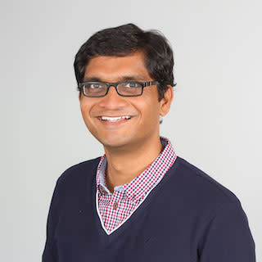



Solving Complex Tasks as Communication with Simple AI Agents
Tushar Khot , Daniel Khashabi, Kyle Richardson Peter Clark and Ashish Sabharwal
NAACL 2021

Slide 36
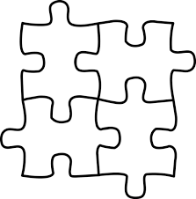





Tail of Compositions
Assumption: we have good models for simple tasks
Goal: solve complex tasks via communication with the simple solver
Complex tasks as
composition of simpler ones
$$\text{🤖}$$
popularity
Can solve simpler tasks
tasks
Notes:
Again, we consider the setup of goal-oriented communication among language models in order to solve a complex task (such as answering compositional questions)
To make this a bit more concrete, …
Our language agents have specific roles.
One side of the interaction we have a “solver” module — which is good at solving simple tasks, but it is essentially blind at solving more complex problems.

Slide 37
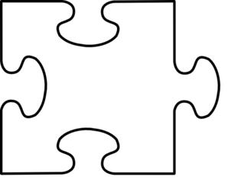


Complex Problem Solving As Communication
Setup:
Communications between models
Goal oriented
Roles: solver and inquisitor
complex task
inquisitor
solver
$$\text{🤖}$$
$$\text{🤖}$$
natural language communication
Can decompose a complex task into simple tasks
Can solve simpler tasks
Notes:
One the left side, we have “inquisitor” module,
which does not know how to solve problems
But it knows how to ask questions about the given goal.
particularly questions that can be solved by the "solver"
For these modules to accomplish a given goal, they need to communicate in natural language.
At every round of communication, inquisitor breaks forms a simpler problems for the "solver" modules
and uses their answers to create follow-up problems

Slide 38




Complex Problem Solving As Communication
complex question
“What is the nationality of the Simpsons director?”
inquisitor
simple question
$$\text{🤖}$$
“Who is the director of the Simpsons?”
solver
$$\text{🤖}$$
“Raymond S. Persi”
inquisitor
simple question
$$\text{🤖}$$
“Who is the nationality of Raymond S. Persi?”
solver
$$\text{🤖}$$
“American”
Notes:
From now on, let’s assume that our complex tasks are compositional questions.
To give you a little sense of how this is supposed to work, let me go back to our running example . . .

Slide 39




Problem Setup
complex question
“What is the nationality of the Simpsons director?”
inquisitor
simple question
$$\text{🤖}$$
“Who is the director of the Simpsons?”
solver
$$\text{🤖}$$
“Raymond S. Persi”
inquisitor
simple question
$$\text{🤖}$$
“Who is the nationality of Raymond S. Persi?”
solver
$$\text{🤖}$$
“American”
Notes:
Now the research question for us to address is what is a principled way to …
And in doing so, we’re not allowed to use explicit human annotations
They’re costly and can limit the generality of our solution.

Slide 40
Problem Setup
Research question: Can we learn to solve complex questions via language interactions with existing, simpler models?
complex question
Given: complex questions
“What is the nationality of the Simpsons director?”
inquisitor
simple question
$$\text{🤖}$$
????
solver
$$\text{🤖}$$
Given: fixed QA solvers for simpler questions
????
inquisitor
simple question
$$\text{🤖}$$
????
solver
$$\text{🤖}$$
Missing: intermediate interactions
“American”
Notes:
In particular, we’re given:
Few instances of complex questions and their answers
Modules for solving simple QA problems -> these "solvers" are fixed (we're not gonna touch them)
What is missing is all these intermediate interactions that are supposed to be generated our "inquisitor"
Now, I’m gonna present our approach to finding these intermediate steps:
Let me just be clear that: I view this as our first effort, which has its own weaknesses.
Improving these limitations will be part of the future work.
--------
Earlier when I discussed text modular networks, we learned to decompose complex questions via a discrete optimization.
One difficulty with this is all the assumptions baked into the decomposition algorithm, which limit the generality of the approach.
I would like to move toward more general algorithms for learning to interact with minimal assumptions.
And in doing so, is actually not easy. To highlight one key challenge here, let’s focus on a subset of this problem
Only the last step …
And intuitively, this should be do-able.
Our neural language models know a lot about structure of language.
So, there must something we can do just by using off-the-self neural LMs.

Slide 41

Attempt 1
Idea: use the gradient signals to reverse engineer intermediate steps that lead to a given outcome.
complex question
“What is the nationality of the Simpsons director?”
inquisitor
simple question
$$\text{🤖}$$
????
solver
$$\text{🤖}$$
????
inquisitor
simple question
$$\text{🤖}$$
????
solver
$$ℒ( )$$
$$\text{🤖}$$
“American”
Notes:
We want to find human-readable questions that “prompt” this given model produce a certain response.
Now, to solve this, one might consider using gradients computed from a loss function that encodes how much mass this fixed model assigns to the given response.
And hopefully use these gradient signals to explore all the language inputs that can make this particular solver produce ”American".
Turns out this is not trivial: in a recent paper, we dig into a reasons behind why
Gradients alone are insufficient to reverse engineer a model.
Gradients in the input of a language model do not lead to human-readable language. → there is class between language fluency and gradients
so, I don't think we can use gradients-only to find these intermediate steps.
Which stresses the importance of further algorithmic innovations here.

Slide 42
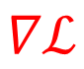





Attempt 1
Idea: use the gradient signals to reverse engineer intermediate steps that lead to a given outcome.
complex question
“What is the nationality of the Simpsons director?”
inquisitor
simple question
$$\text{🤖}$$
????
solver
$$\text{🤖}$$
????
inquisitor
simple question
$$\text{🤖}$$
$$∇ℒ$$
????
solver
$$ℒ( )$$
$$\text{🤖}$$
“American”
Notes:
We want to find human-readable questions that “prompt” this given model produce a certain response.
Now, to solve this, one might consider using gradients computed from a loss function that encodes how much mass this fixed model assigns to the given response.
And hopefully use these gradient signals to explore all the language inputs that can make this particular solver produce ”American".
Turns out this is not trivial: in a recent paper, we dig into a reasons behind why
Gradients alone are insufficient to reverse engineer a model.
Gradients in the input of a language model do not lead to human-readable language. → there is class between language fluency and gradients
so, I don't think we can use gradients-only to find these intermediate steps.
Which stresses the importance of further algorithmic innovations here.

Slide 43
Attempt 1
Prompt waywardness: Continuous prompts are not interpretable.
Corollary: Gradients alone are insufficient to reverse engineer a model.
Idea: use the gradient signals to reverse engineer intermediate steps that lead to a given outcome.
complex question
“What is the nationality of the Simpsons director?”
inquisitor
simple question
$$\text{🤖}$$
????
solver
$$\text{🤖}$$
????
inquisitor
simple question
$$\text{🤖}$$
$$∇ℒ$$
????
solver
$$ℒ( )$$
$$\text{🤖}$$
“American”
“Promp Waywardness: The Curious Case of Discretized Interpretation of Continuous Prompts” Khashabi+ NAACL 2022
Notes:
We want to find human-readable questions that “prompt” this given model produce a certain response.
Now, to solve this, one might consider using gradients computed from a loss function that encodes how much mass this fixed model assigns to the given response.
And hopefully use these gradient signals to explore all the language inputs that can make this particular solver produce ”American".
Turns out this is not trivial: in a recent paper, we dig into a reasons behind why
Gradients alone are insufficient to reverse engineer a model.
Gradients in the input of a language model do not lead to human-readable language. → there is class between language fluency and gradients
so, I don't think we can use gradients-only to find these intermediate steps.
Which stresses the importance of further algorithmic innovations here.

Slide 44
Attempt 2
Idea: search a set simple questions that lend the best support.
complex question
“What is the nationality of the Simpsons director?”
????
answer
“American”

Slide 45


Attempt 2
Idea: search a set simple questions that lend the best support.
solver
complex question
$$\text{🤖}$$
“What is the nationality of the Simpsons director?”
$$\left\{\begin{matrix} \\ \begin{aligned} \\ \\ \\ \\ \\ \end{aligned}\end{matrix}. \right\}$$
"Little Big Girl" is in which season of "the Simpsons"'s?
“Who is the director of Simpson’s ‘Little Big Girl’?”
????
"Little Big Girl" is which episode of "the Simpsons"'s?
When was ‘Little Big Girl’ aired in USA?
Who is the writer of ‘Little Big Girl’ episode?
answer
“American”
...

Slide 46
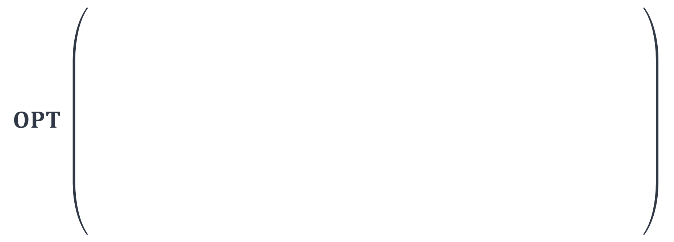
Attempt 2
Idea: search a set simple questions that lend the best support.
solver
$$\text{🤖}$$
$$OPT \left(\begin{aligned} \\ \\ \\ \\ \\ \\ \\ \\ \end{aligned} \right)$$
complex question
“What is the nationality of the Simpsons director?”
$$\left\{\begin{matrix} \\ \begin{aligned} \\ \\ \\ \\ \\ \end{aligned}\end{matrix}. \right\}$$
"Little Big Girl" is in which season of "the Simpsons"'s?
“Who is the director of Simpson’s ‘Little Big Girl’?”
????
"Little Big Girl" is which episode of "the Simpsons"'s?
When was ‘Little Big Girl’ aired in USA?
Who is the writer of ‘Little Big Girl’ episode?
answer
“American”
...

Slide 47
Attempt 2
Idea: search a set simple questions that lend the best support.
solver
complex question
$$\text{🤖}$$
“What is the nationality of the Simpsons director?”
$$\left\{\begin{matrix} \\ \begin{aligned} \\ \\ \\ \\ \\ \end{aligned}\end{matrix}. \right\}$$
"Little Big Girl" is in which season of "the Simpsons"'s?
simple Q1
Bridging phenomenon
(e.g., deductive reasoning)
Q1 answer
“Who is the director of Simpson’s ‘Little Big Girl’?”
"Little Big Girl" is which episode of "the Simpsons"'s?
simple Q2
When was ‘Little Big Girl’ aired in USA?
Q2 answer
Who is the writer of ‘Little Big Girl’ episode?
answer
“American”
...
Notes:
For example, reasoning structure that are a sequences of intermediate steps (often 2 or 3 intermediate steps).

Slide 48
Attempt 2
Idea: search a set simple questions that lend the best support.
solver
complex question
$$\text{🤖}$$
“What is the nationality of the Simpsons director?”
$$\left\{\begin{matrix} \\ \begin{aligned} \\ \\ \\ \\ \\ \end{aligned}\end{matrix}. \right\}$$
"Little Big Girl" is in which season of "the Simpsons"'s?
simple Q1
simple Q2
Comparison phenomenon
(e.g., conjunction, difference)
“Who is the director of Simpson’s ‘Little Big Girl’?”
Q1 answer
Q2 answer
"Little Big Girl" is which episode of "the Simpsons"'s?
simple Q3
When was ‘Little Big Girl’ aired in USA?
Q3 answer
Who is the writer of ‘Little Big Girl’ episode?
answer
“American”
...
Notes:
Other reasoning structures can include parallel steps, for example.
Essentially all these different valid “structures” can be implemented as constraints of this discrete optimization and
Our search is in charge of picking one

Slide 49

Attempt 2
Idea: search a set simple questions that lend the best support.
complex question
“What is the nationality of the Simpsons director?”
“Who is the director of the Simpsons?”
inquisitor
“Raymond Persi”
$$\text{🤖}$$
Trained on [noisy] decompositions
“What is the nationality of Raymond S. Persi?”
“American”
No decomposition annotation needed!
answer
“American”
Notes:
Other reasoning structures can include parallel steps, for example.
Essentially all these different valid “structures” can be implemented as constraints of this discrete optimization and
Our search is in charge of picking one

Slide 50
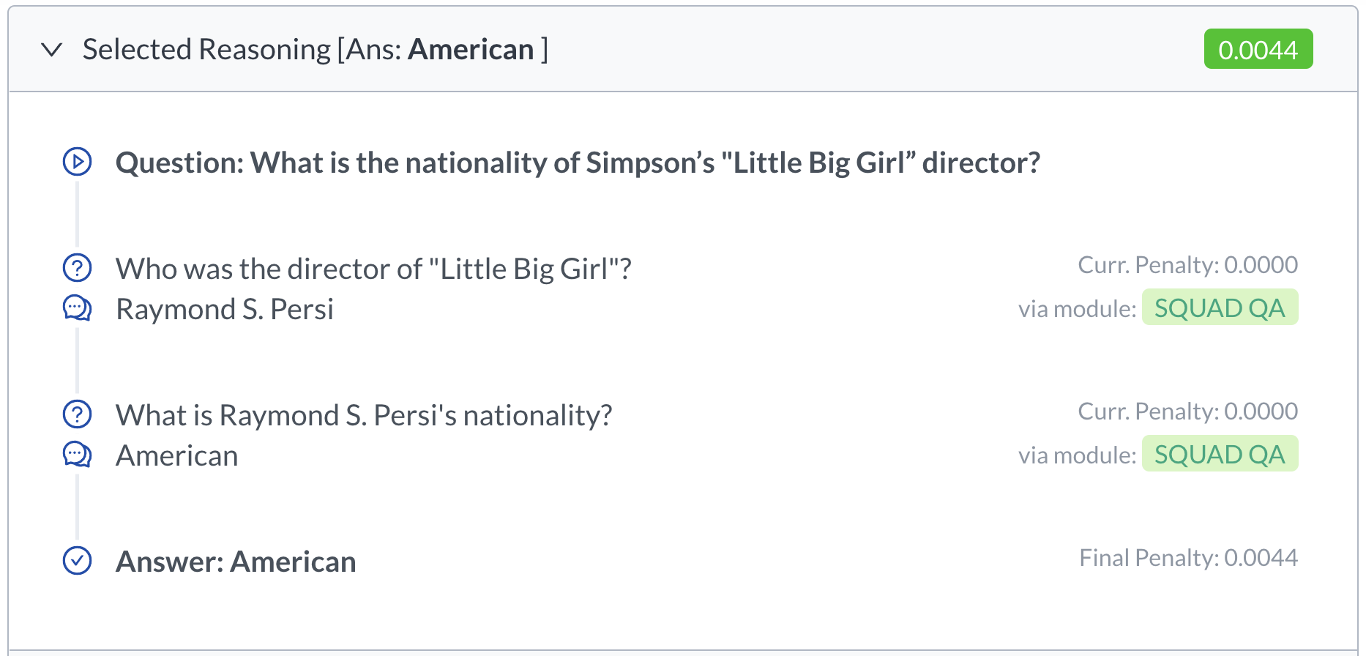
Demo
https://modularqa-demo.apps.allenai.org/
Notes:
What is the nationality of Simpson’s "Little Big Girl” director?
What other movie(s) is directed by the director of Simpson’s "Little Big Girl”?
What network broadcast the Simpsons episode directed by Raymond Persi?
Raymond Persi directed which episode(s) of The Simpsons?

Slide 51
Summary of Empirical Observations
On several complex QA datasets, the resulting model:
is competitive with dataset-specific.
while providing a level of transparency into the reasoning process.
Note: a single model on multiple datasets.
Caveats:
Will discuss.
“Learning to Decompose Tasks in the Language of Existing Models.” Khot, Khashabi, Richardson, Sabharwal. NAACL 2021
Notes:
And finally, to better understand the interpretability of the interactions (as explanations of the underlying reasoning)
we evaluate them via human judgements, compared to another work,
that uses templates to decompose questions.
crowdworkers deemed that
understood our natural language explanations better,
and trusted them in terms of their correctness.

Slide 52


Summary
popularity
Motivating Question: Can we solve complex tasks as communication with simpler models?
Approach: discrete optimization on queries answerable by existing simple models.
Limitations?
tasks
Notes:
We were motived by the question of :
….
- Extensibility, both in terms of new “solvers”/modules and new desirable reasoning structures, which I’m gonna get back to as future work.

Slide 53
Limitations
The space of simple queries is massive -> difficult optimization.
Notes:
In the 2nd part of the talk, we tackled compositional statements, by breaking them into smaller constituents.
One hidden assumption that we relied on was explicitness of compositions, even though many compositions in language are implicit.
Take this example from a benchmark that we published last year:
Did Aristotle use a laptop?
You all know that the answer is “no”. How should a model know that? Nothing here gives us any clues about how reasoning should be done.
An explicit version of this question is …,
Which explicitly laysout everything that one needs to look up: …
Currently we (the community) can address explicit compositions to some extend, but we have nothing to say regarding implicit compositions.
So the goal here is …
And as I said, we have built a benchmark as a preliminary work to motivate research in this direction.

Slide 54
Limitations
The space of simple queries is massive -> difficult optimization.
Not “general” with respect to composition structures.
We probably should learn these from data, as opposed to hand-coding them.
complex tasks
complex tasks
…
simple Q1
simple Q2
simple Q2
Q1 answer
Q2 answer
Q2 answer
simple Q3
simple Q3
Q3 answer
Q3 answer
answer
answer
Notes:
In the 2nd part of the talk, we tackled compositional statements, by breaking them into smaller constituents.
One hidden assumption that we relied on was explicitness of compositions, even though many compositions in language are implicit.
Take this example from a benchmark that we published last year:
Did Aristotle use a laptop?
You all know that the answer is “no”. How should a model know that? Nothing here gives us any clues about how reasoning should be done.
An explicit version of this question is …,
Which explicitly laysout everything that one needs to look up: …
Currently we (the community) can address explicit compositions to some extend, but we have nothing to say regarding implicit compositions.
So the goal here is …
And as I said, we have built a benchmark as a preliminary work to motivate research in this direction.

Slide 55
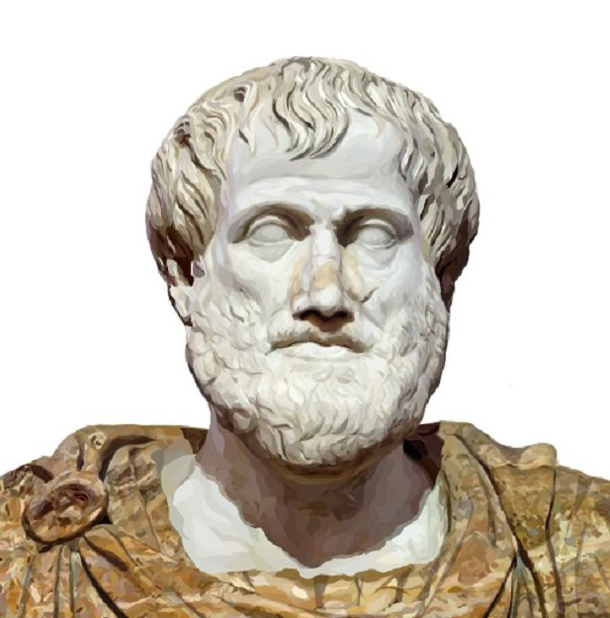
Limitations
The space of simple queries is massive -> difficult optimization.
Not “general” with respect to composition structures.
Would not handle implicit compositions.
implicit
Did Aristotle use a laptop?
explicit
Were laptops invented before Aristotle was born?
Notes:
In the 2nd part of the talk, we tackled compositional statements, by breaking them into smaller constituents.
One hidden assumption that we relied on was explicitness of compositions, even though many compositions in language are implicit.
Take this example from a benchmark that we published last year:
Did Aristotle use a laptop?
You all know that the answer is “no”. How should a model know that? Nothing here gives us any clues about how reasoning should be done.
An explicit version of this question is …,
Which explicitly laysout everything that one needs to look up: …
Currently we (the community) can address explicit compositions to some extend, but we have nothing to say regarding implicit compositions.
So the goal here is …
And as I said, we have built a benchmark as a preliminary work to motivate research in this direction.

Slide 56
Limitations
The space of simple queries is massive -> difficult optimization.
What compositions are valid (convincing)?
Not grounded The space of simple tasks one can solve continually changes.
Examples:
If the items in the kitchen/fridge change, the space of things you can do also changes.
If the board game rules changes, the space of complex tasks also change.

Slide 57
Mention other related work that have done related studies.
Nathaniel’s work.
CoT

Slide 58
Today
Several ideas in the direction of maximizing generality and control.
Instruction-tuning
Wang+ 2022, Mishra+ 2022
Communication with AI agents
Khot+ 2021, Khot+ 2022
Sampling from language models
Qin+ 2022
Notes:
These are in a way are three different bets.
None of these solve the challenge, but I think each have
It’s possible that all of these different approaches are necessary for the ultimate solution. It’s also possible that none of them are needed.

Slide 59
Today
Several ideas in the direction of maximizing generality and control.
Instruction-tuning
Wang+ 2022, Mishra+ 2022
Communication with AI agents
Khot+ 2021, Khot+ 2022
Sampling from language models
Qin+ 2022
Notes:
These are in a way are three different bets.
None of these solve the challenge, but I think each have
It’s possible that all of these different approaches are necessary for the ultimate solution. It’s also possible that none of them are needed.

Slide 60
Back to LMs
Hypothesis: LMs know more than what we can surface via prompts.
Notes:
This is, in fact, fundamentally what autoregressive models do. Given a sequence, which here we are calling y_1, y_2, ... and so on, an autoregressive model tries to predict y_t from all of the sequence entries before y_t.

Slide 61
Hypothesis: LMs know more than what we can surface via prompts.
Joe lived a lonely life.
What happened next?
Notes:
Another aspect to reasoning that makes it challenging is its “non-monotonicity” of human reasoning.
Upon getting more information we might retract prior conclusions.
Take this example:
… what is a good follow-up for this story?

Slide 62
Hypothesis: LMs know more than what we can surface via prompts.
He started smoking to cope with the issue
Joe lived a lonely life.
???
He was much happier now that he has companions.
Non-monotonicity — retracting conclusions upon further evidence.
Notes:
Another aspect to reasoning that makes it challenging is its “non-monotonicity” of human reasoning.
Upon getting more information we might retract prior conclusions.
Take this example:
… what is a good follow-up for this story?

Slide 63
LM
language response
language commands

Slide 64

✨🪄
LM
language commands
computable objectives
language response

Slide 65
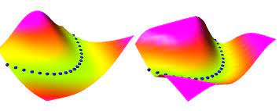

computable objectives
LM
language response
language commands
E=
Energy function E(x, y):
Scalar value
Low values when x and y are compatible
Inference:
Find values of y that lead to a small E(x, y) for a given x.
[lots of prior work in thermodynamics, dynamical systems, information theory, Bayesian inference, etc.]

Slide 66




COLD Decoding
Energy-based Constrained Text Generation with Langevin Dynamics
Lianhui Qin, Sean Wellleck, Daniel Khashabi, Yejin Choi
NeurIPS 2022

Slide 67
Constraints:
Past Coherence + Future Coherence
He was much happier now that he has companions.
Joe lived a lonely life.
Past
Future
Joe decided to join a social club.
Generation
[Bhagavatula+ 2021; Hobbs+ 1988; Peirce 1965 and many others]
Notes:
Which involves soft constraint.

Slide 68
Energy Function for Text Generation
Until he joined a social club ...
E=
Left Coherence
He started smoking …
Energy

Slide 69
Energy Function for Text Generation
Until he joined a social club ...
E=
Left Coherence
+ Right Coherence
He started smoking …
Energy

Slide 70

Energy Function for Text Generation
Until he joined a social club ...
E=
Left Coherence
+ Right Coherence
+ . . .
He started smoking …
Energy
Energy function is flexible!

Slide 71
Sampling from the Energy Function
Until he joined a social club ...
Find values of y that lead to a small E(x, y) for a given x.
Options for discrete search:
Exhaustive search, heuristic search, MCMC/Metropolis-Hastings, simulated annealing, …
Sampling approach studies here:
Langevin dynamics (equivalent to SGD)
Energy
He started smoking …
[Bishop & Nasrabadi 2006; Welling & Teh 2011; Du & Mordatch 2019 ]

Slide 72

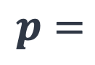
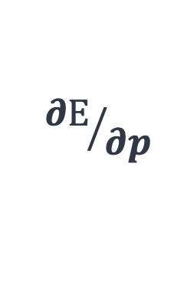
Sampling from the Energy Function
constraint text generation as sampling from an energy function
$$\text{🤖}$$
$${∂E}/{∂p}$$
$$p=$$
…
He was much happier now that he has companions.
Joe lived a lonely life.
_________?__________
Note: LM parameters are not modified.
Notes:
I just wanna showcase an exciting recent work on this goal, fresh from the even.
We propose an unsupervised framework for text generation with constraints,
utilizing techniques borrowed from statistical sampling of energy functions
Using this framework we can solve the example I mentioned earlier, without any labeled data (only through sampled from an off-the-shelf LM).
This is just one small algorithmic progress; there is a lot to be done here.

Slide 73
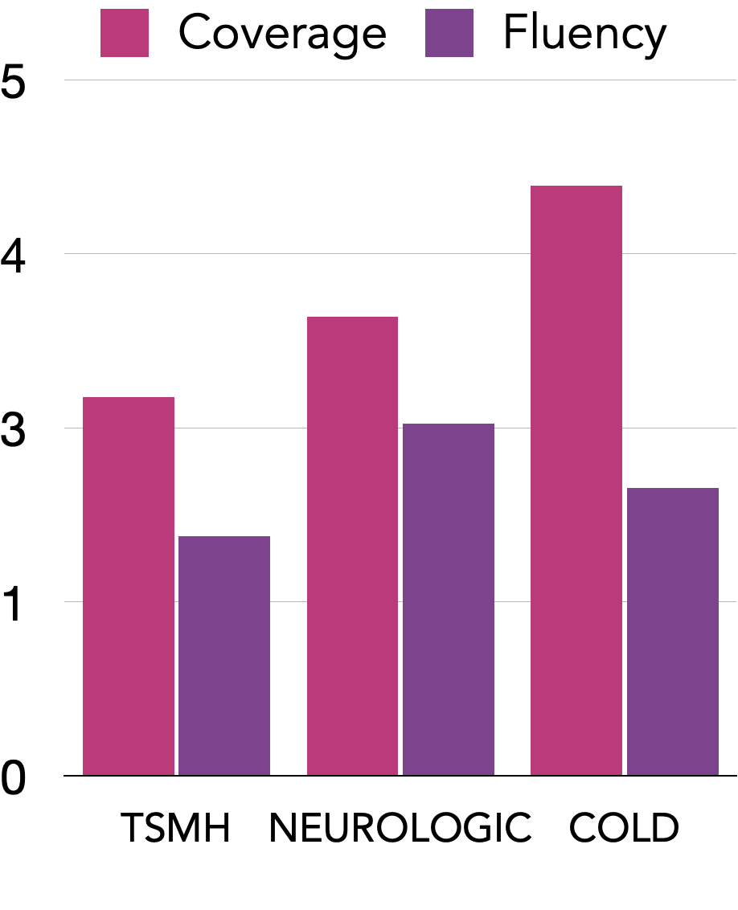
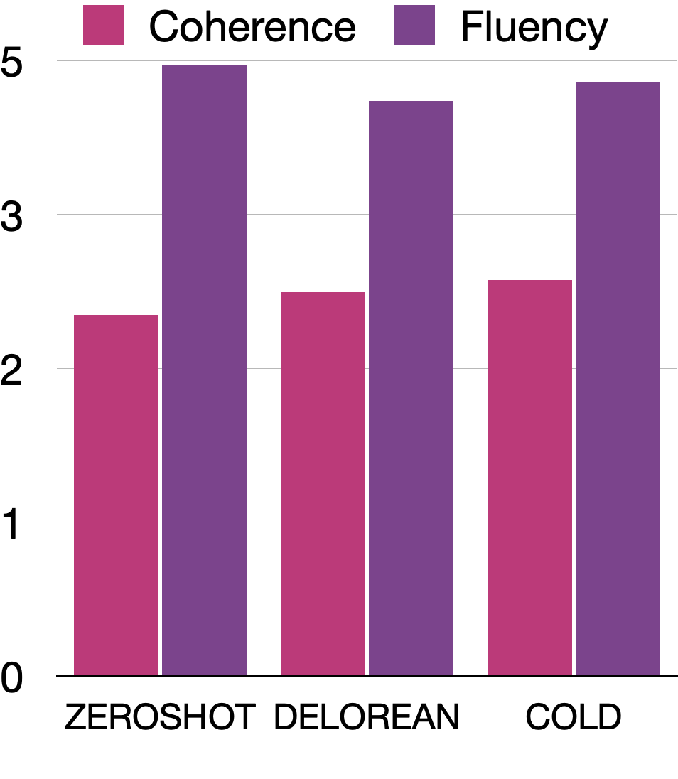
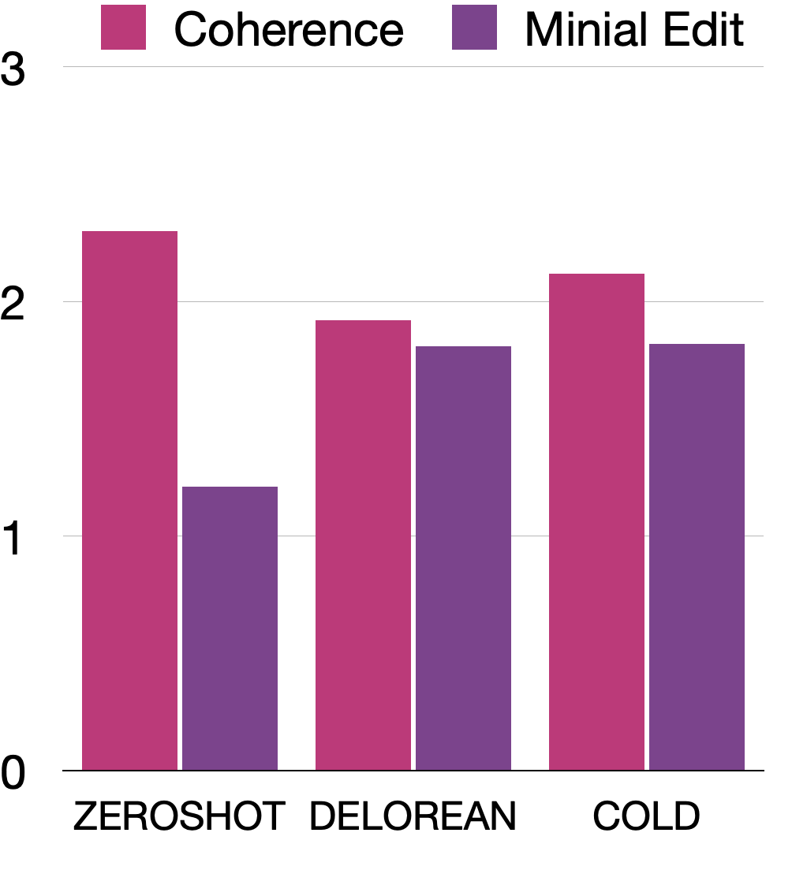



COLD Decoding
Lexically Constrained Generation
Abductive Reasoning
Counterfactual Reasoning
COLD: $E$ = fluency + key words
COLD: $E$ = left coherence + right coherence
COLD: $E$ = coherence + minimal edit
Improvements in applying “constraints” while maintaining fluency.
Notes:
I am going into the details …
More task in the paper

Slide 74

Summary
Motivating Question: How much more do frozen language models know about the world?
Approach: sampling from “focused” distribution of off-the-shelf language model.
Limitations?
Generality
LMs
an ideal design
specialized models
Control
Notes:
We were motived by the question of :
….
- Extensibility, both in terms of new “solvers”/modules and new desirable reasoning structures, which I’m gonna get back to as future work.

Slide 75
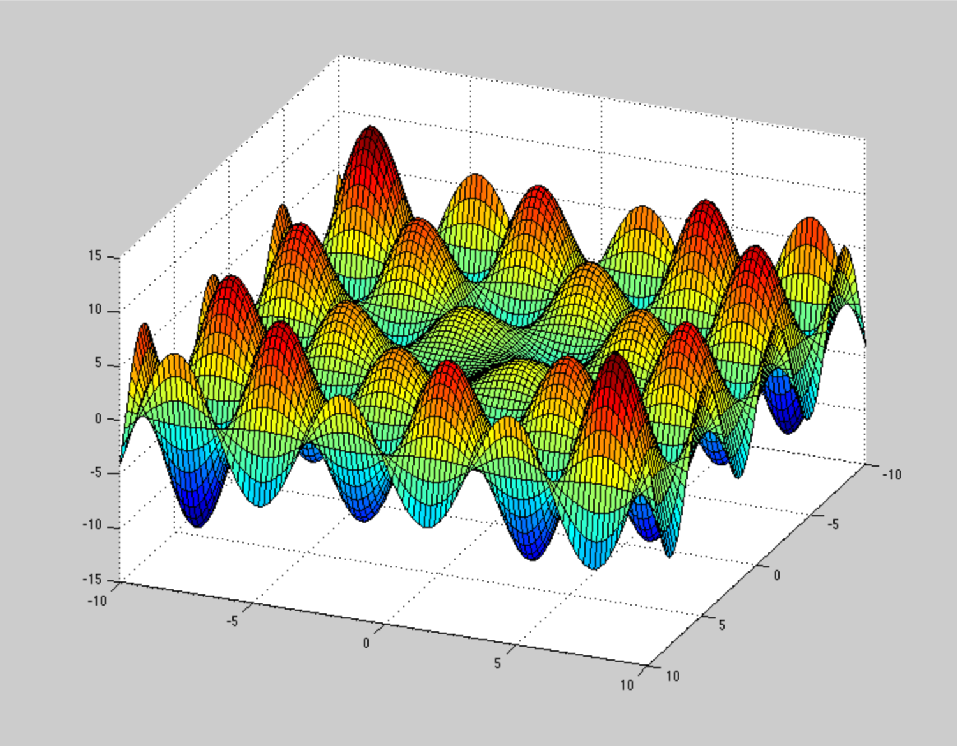
LMs as Energy Functions: Limitations
Sampling from energy functions remains extremely difficult.

Slide 76

LMs as Energy Functions: Limitations (2)
Sampling from energy functions remains extremely difficult.
Mapping language to energy functions is not trivial.
✨🪄
LM
language commands
computable objectives
language response

Slide 77
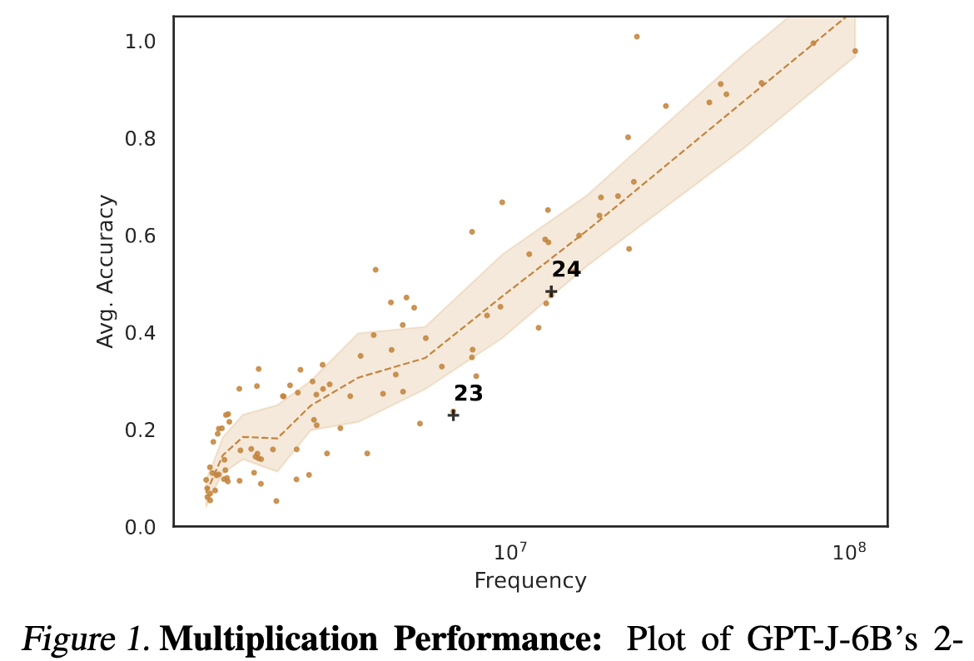
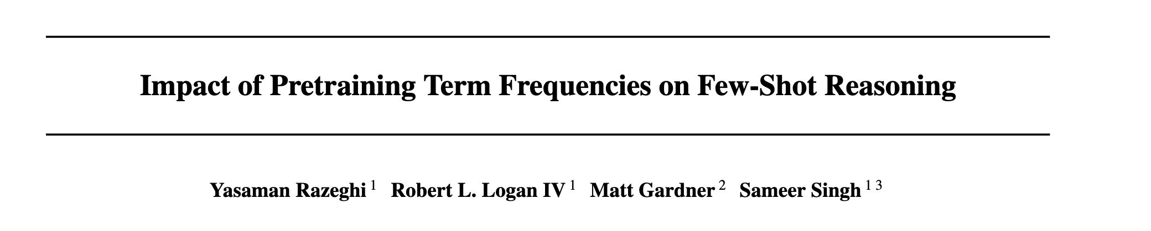
LMs as Energy Functions: Limitations (3)
Sampling from energy functions remains extremely difficult.
Mapping language to energy functions is not trivial.
LMs are not robust in the distribution tail — limited generality.
popularity
tasks
Notes:
Scale is not all you need.

Slide 78

Tying the Loose Ends
Currently, we do not focus enough on the “generality” of our progress.
Many are obsessed with victories in narrowly-defined tasks.
Need to rethink our path to more “general” models.
defining setups that incentivize more general designs.
Generality
LMs
an ideal design
specialized models
Control
Notes:
Let go back to the big picture to tie the loose ends.
Like I argued, in the current state of NLP field, we do not focus enough “generality” of our progress,
many in NLP are obsessed with narrow designs (e.g., dataset-specific models or chasing leaderboards for individual datasets).
In contrast, “generality” in design philosophy needs to be discussed more.
As I said in the intro, what means to be more “general” is itself open-ended and likely has many facets to it.
Defining it part of the progress.
Here, presented a particular perspective on this:
…..
Needless to say, this is not all that there is to “generality”
In a way, I view these as small steps towards “generality”. we’re really just at the top of the iceberg.
and there is a lot that needs to be done here.
Which brings me to the discussion of future work.

Slide 79
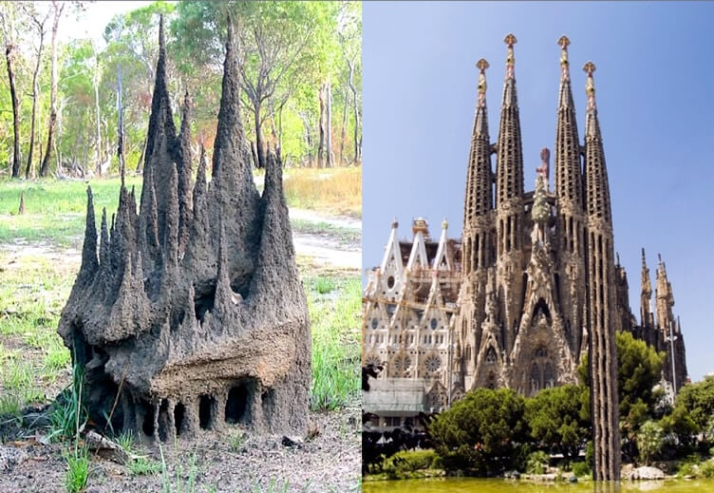
[Inspiration: Dan Dennett]

